Slide 1

Introducing DesignDeck: Design & Code Upload Platform
DesignDeck is a new platform to upload design and code. We use modern technologies for a seamless experience.

Slide 2

Tech Stack Deep Dive: Modern Technologies
Frontend
Backend
React for UI. Tailwind CSS for styling.
Node.js with Express.js. MongoDB with Mongoose.

Slide 3




Weekly progress of
DesignDeck
UI Design Complete
Frontend Development In Progress
Key Pages in Progress
Profile page for other users, Project Upload Page, Edit Profile Page etc…

Slide 4

Phase Completion: UI Design
1
The UI design phase is now complete.
2
The main principles focused on user needs, easy access for everyone, and a uniform design.
3
The design system encompasses typography, color palettes, and UI elements.
4
Examples include bright and attractive colors, easy-to-read fonts, and a well-organized set of design elements.

Slide 5
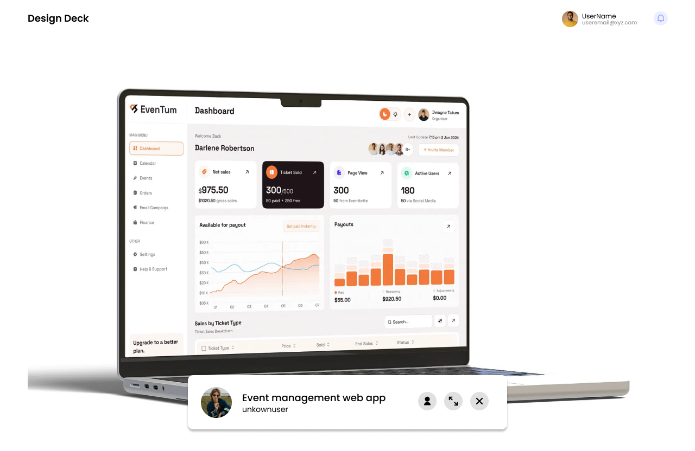
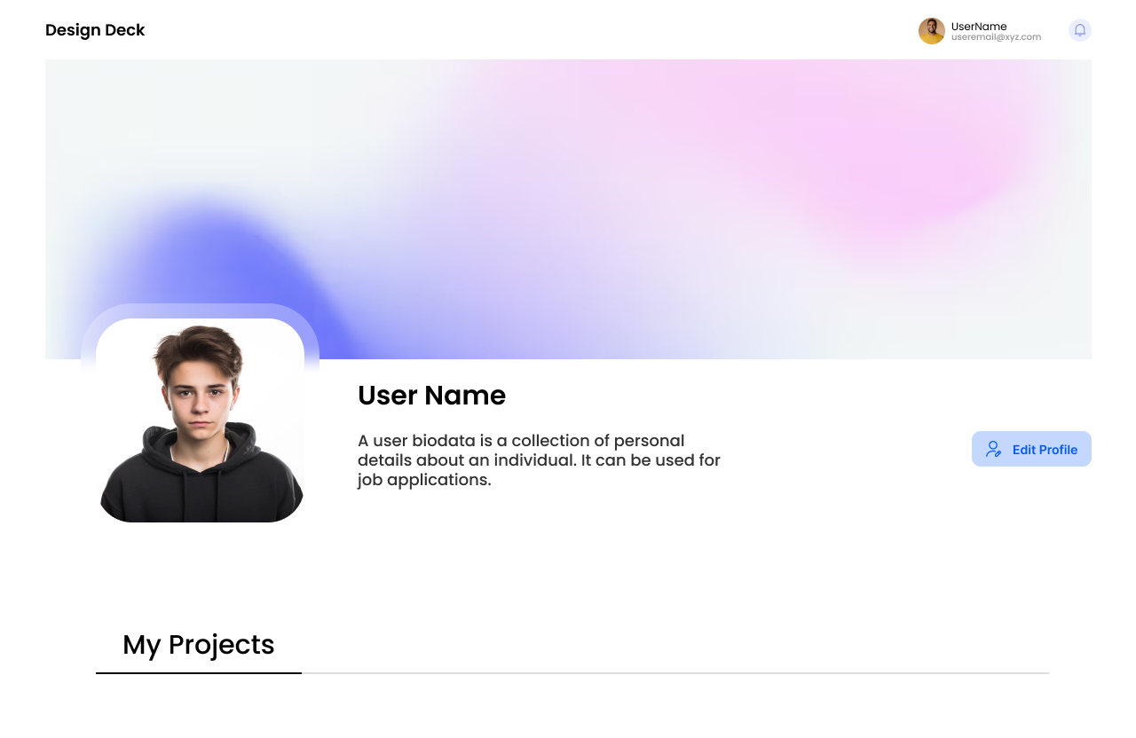
User Interface Screenshots
Particular Project Show Page
Profile page for user

Slide 6
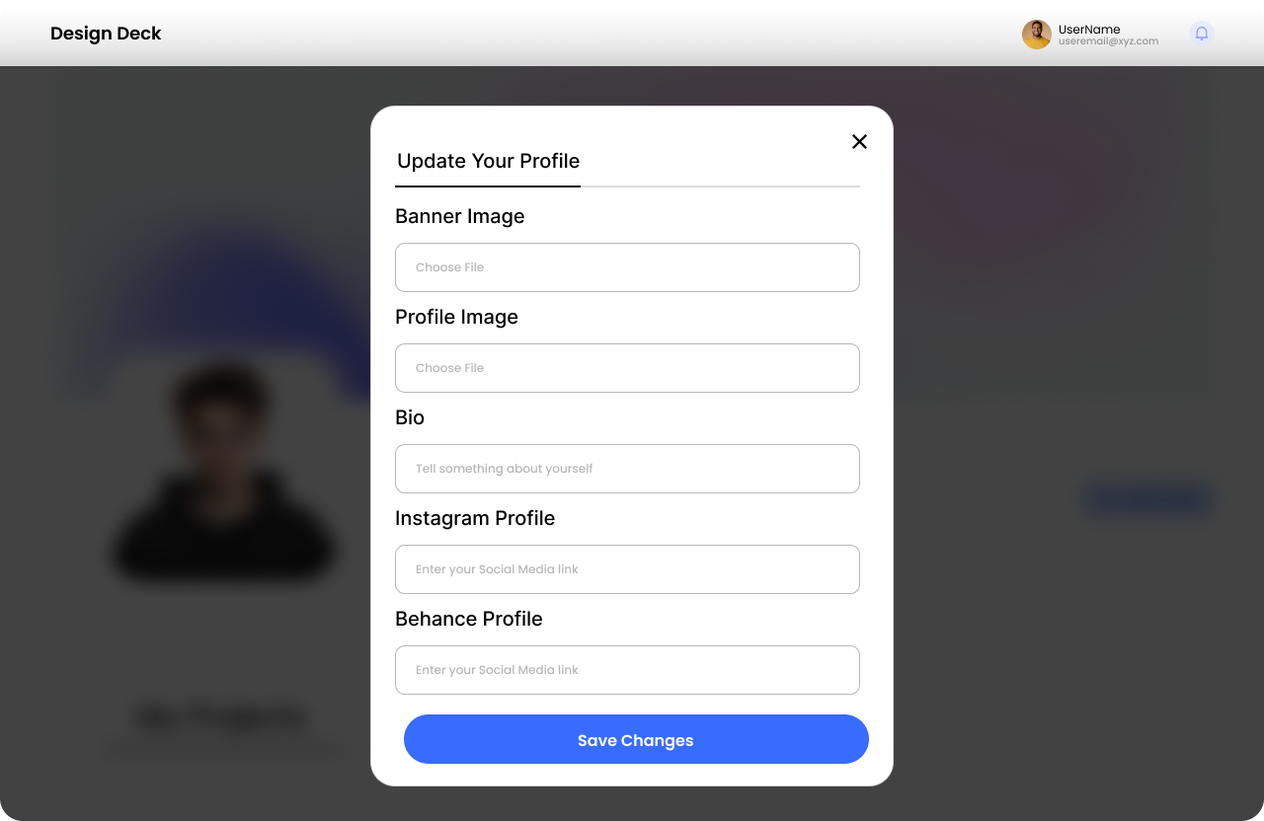
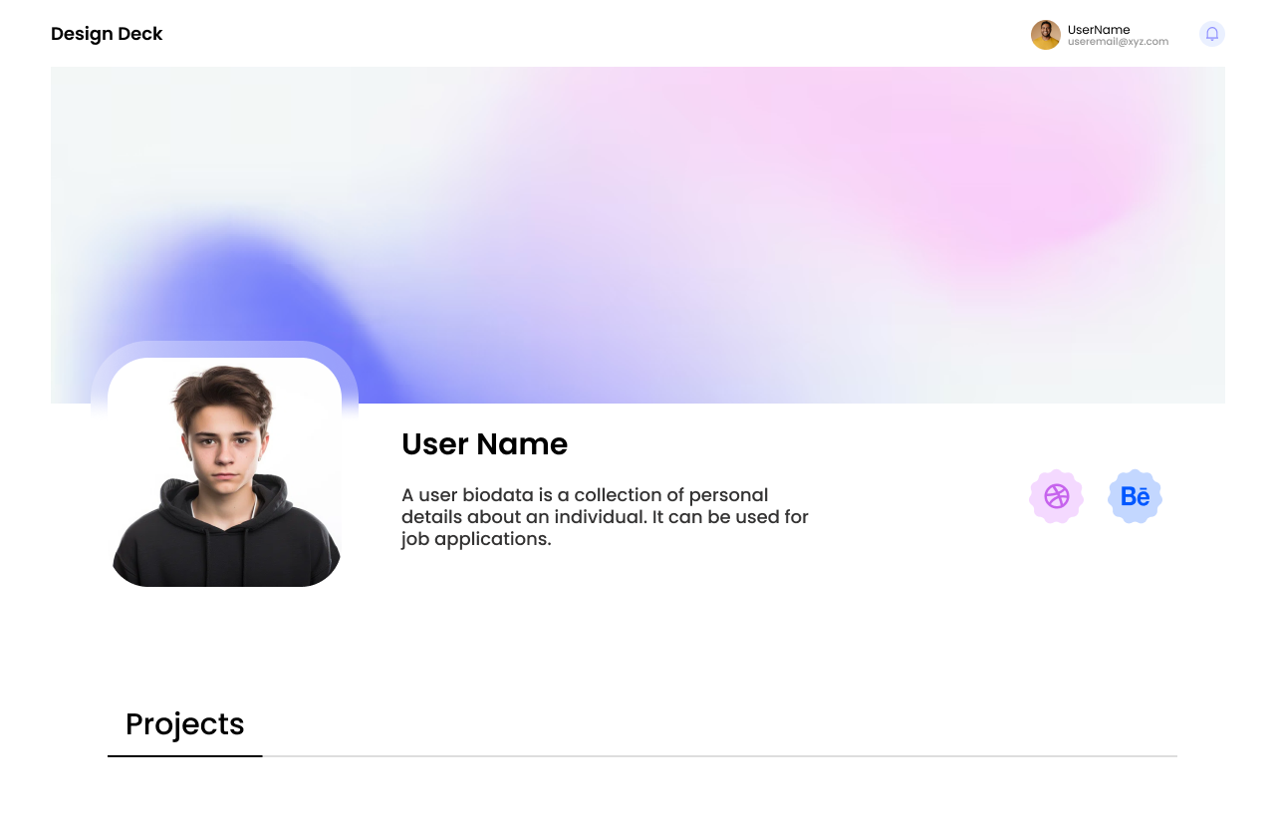
User Interface Screenshots
Edit Profile Page
Profile Page for others users

Slide 7
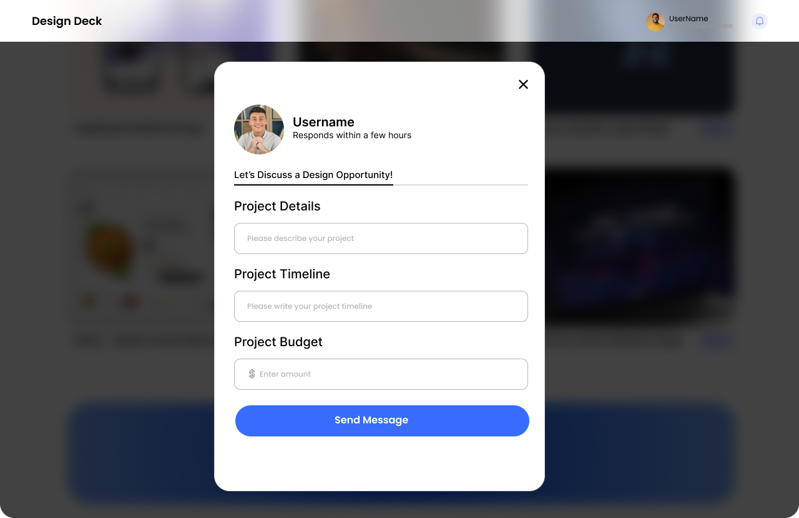
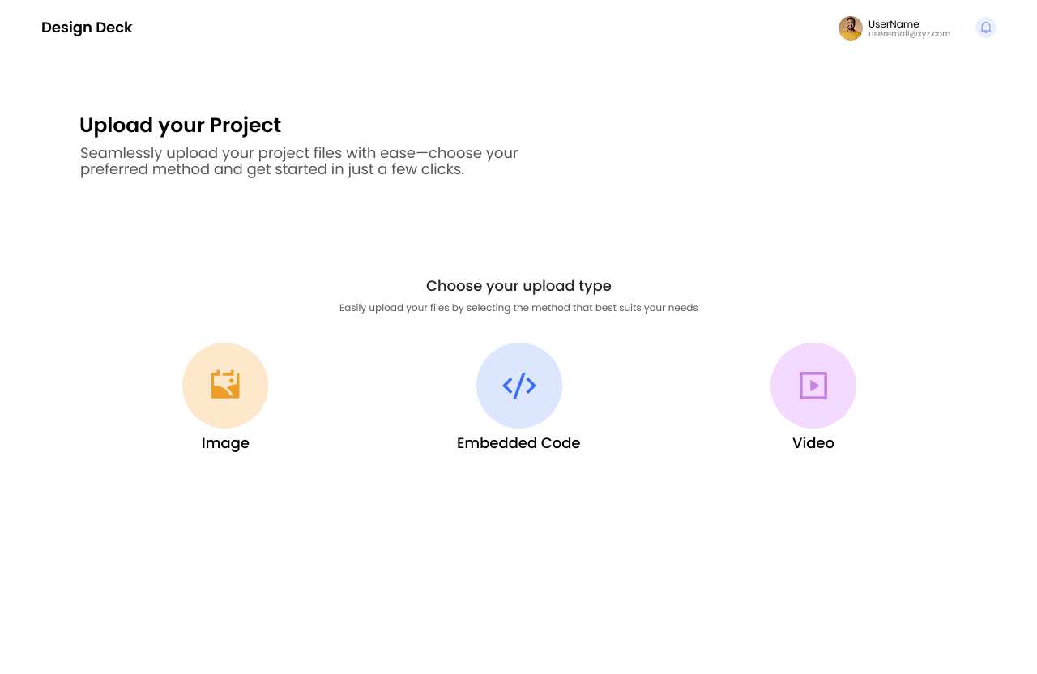
User Interface Screenshots
Contact to other user
Upload Project Page

Slide 8
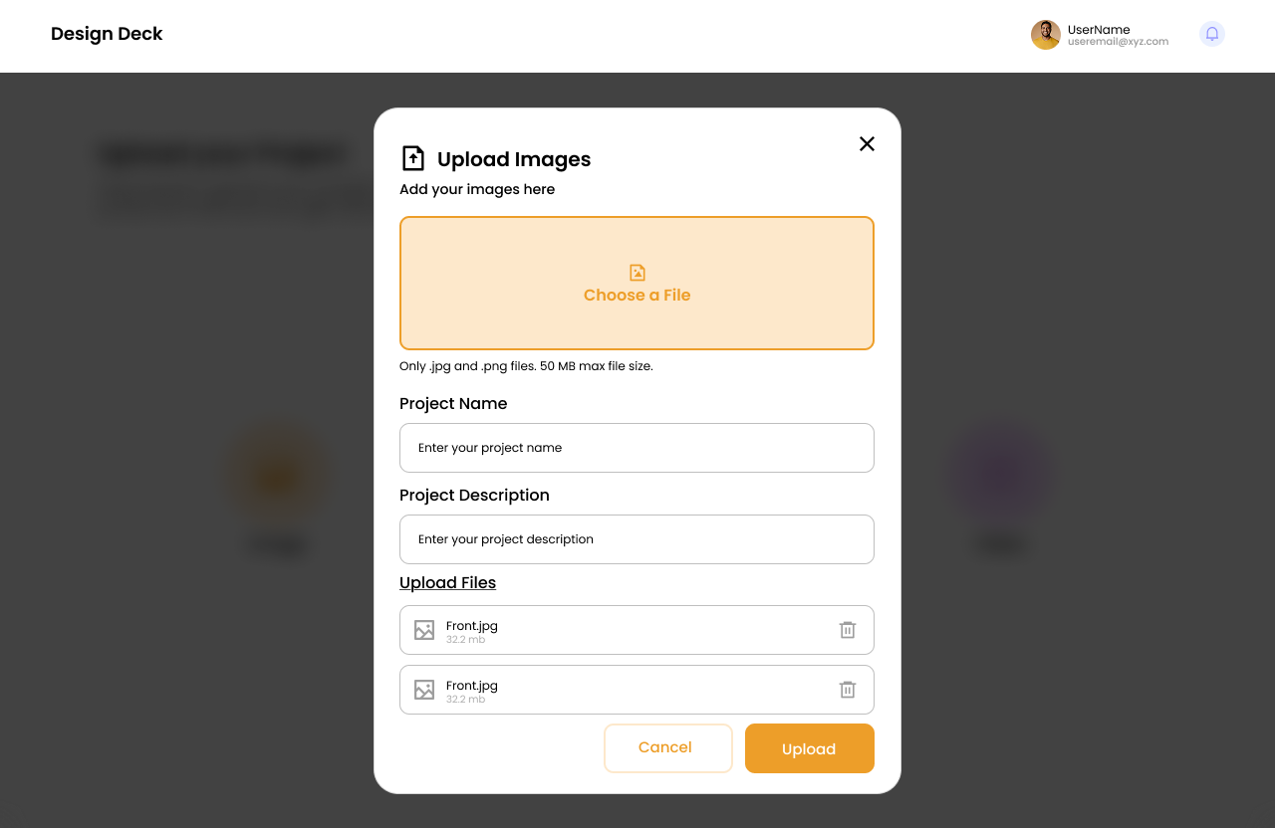
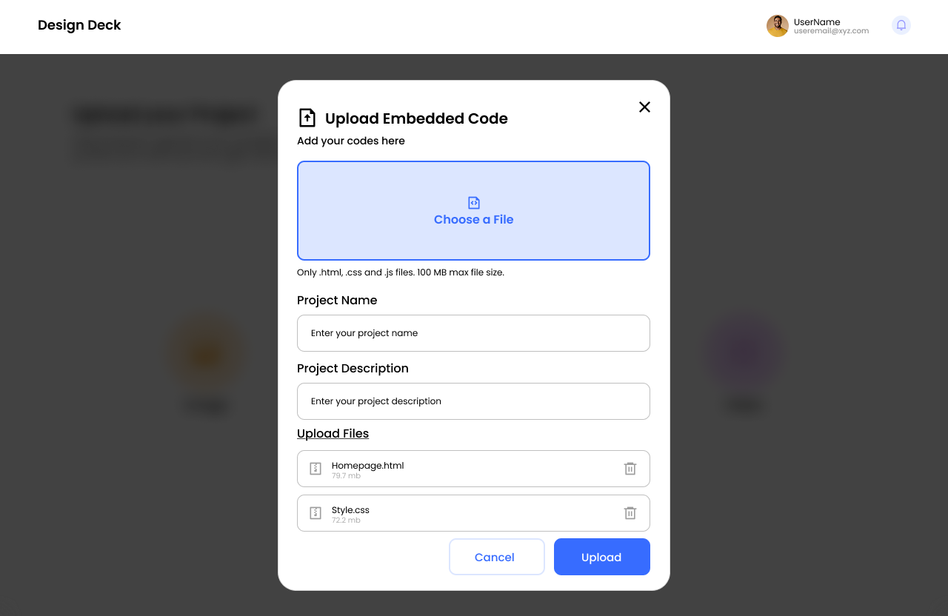
User Interface Screenshots
Image Upload Page
Embedded code Upload Page

Slide 9
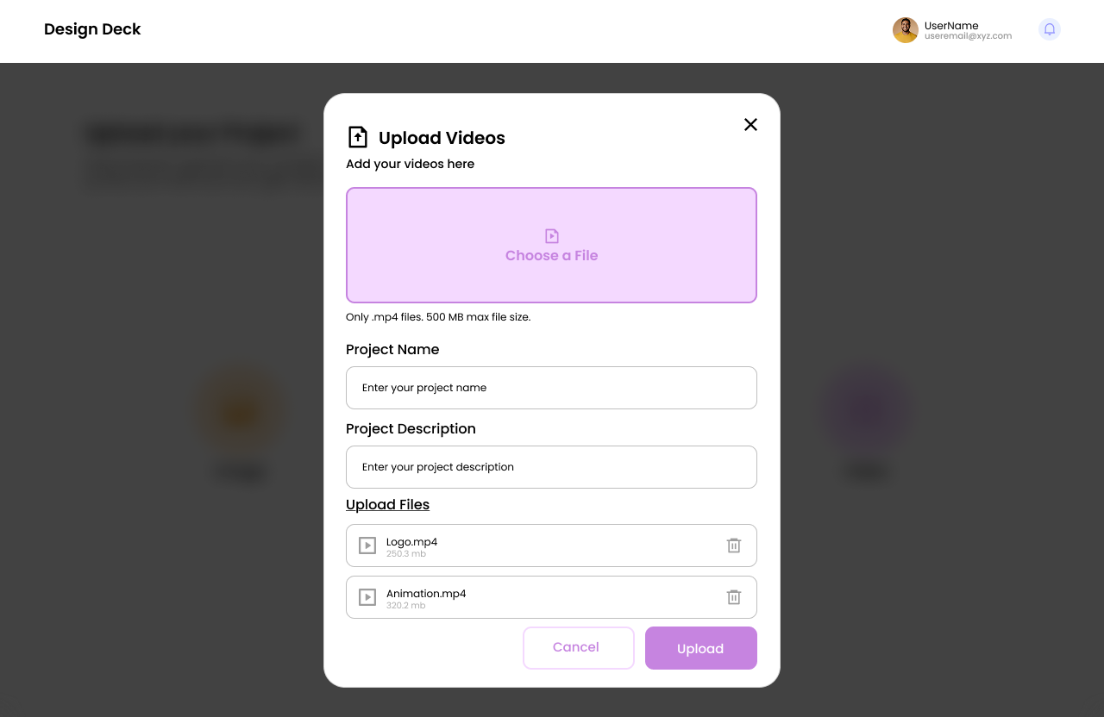
User Interface Screenshots
Video Upload Page

Slide 10
Starting Frontend Development
Frontend development focuses on creating visually appealing and interactive web applications. HTML structures the content, Tailwind CSS provides a flexible and responsive design, JavaScript adds dynamic functionality, and React helps build efficient, reusable components. These technologies work together to create modern, fast, and user-friendly websites with a seamless user experience.

Slide 11
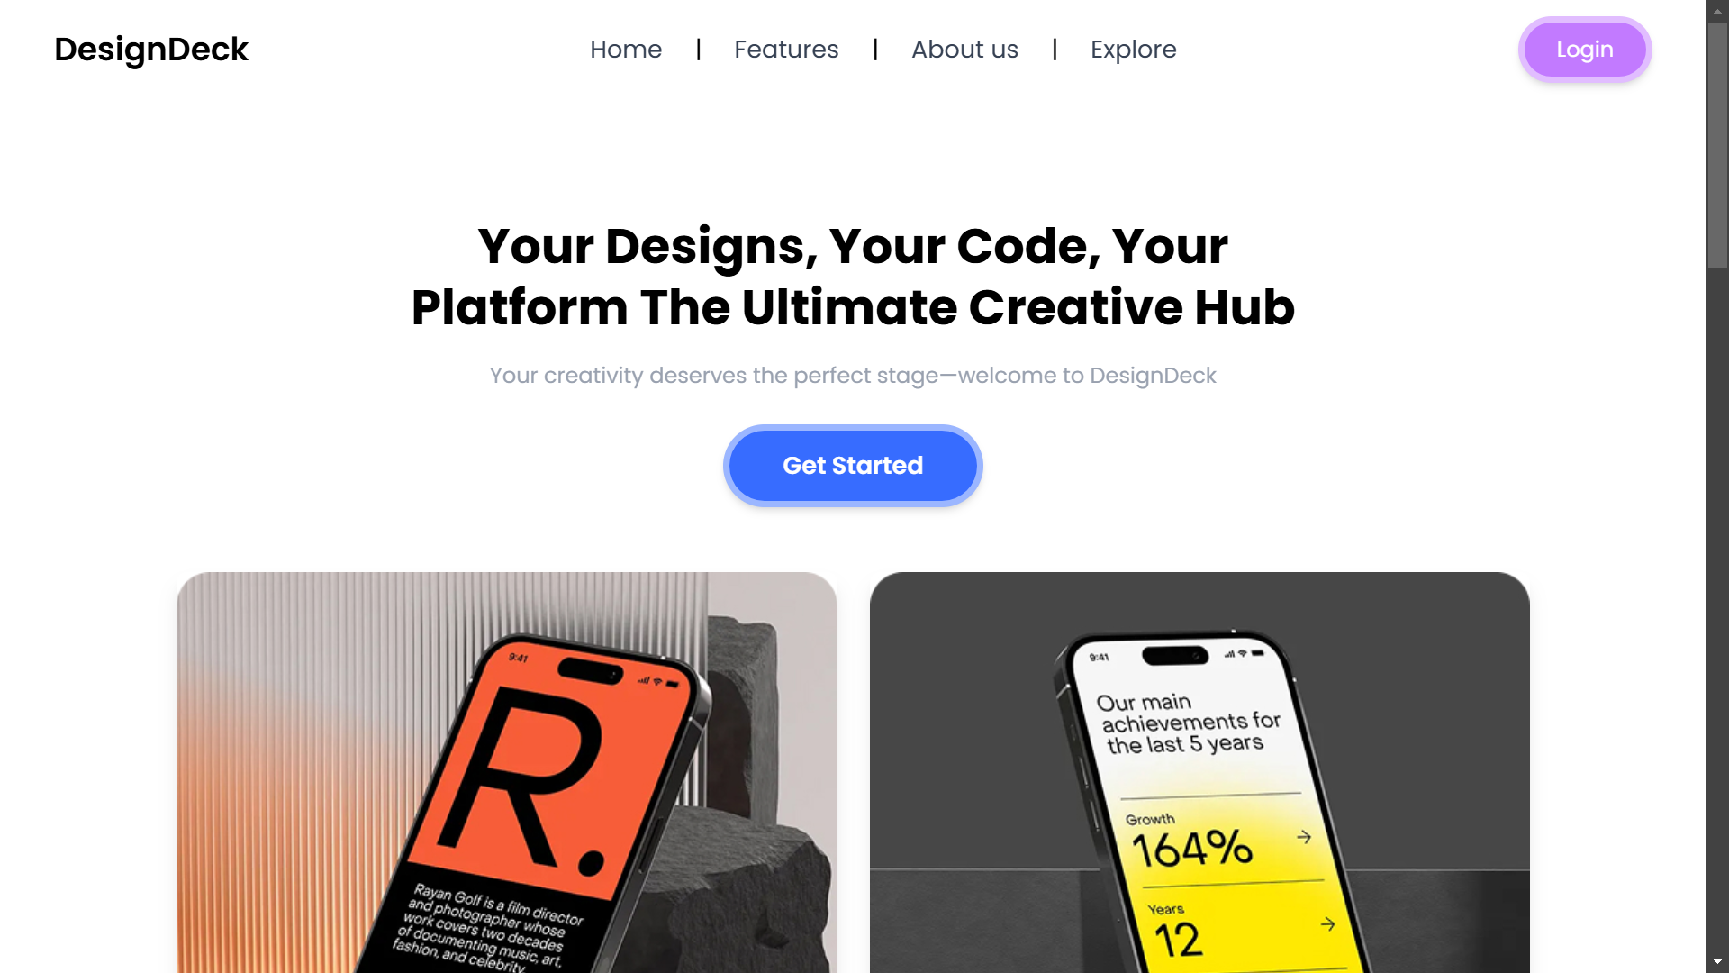
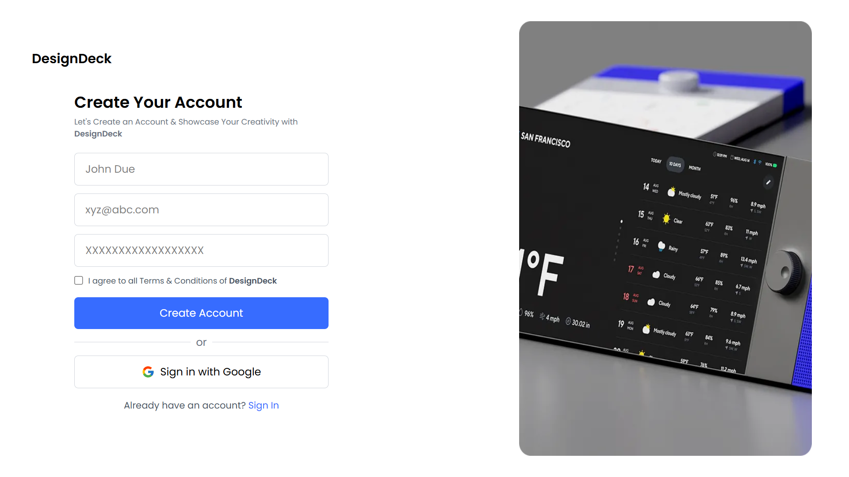
Screenshot Showcase : Frontend Development
Landing Page
Signup Page

Slide 12
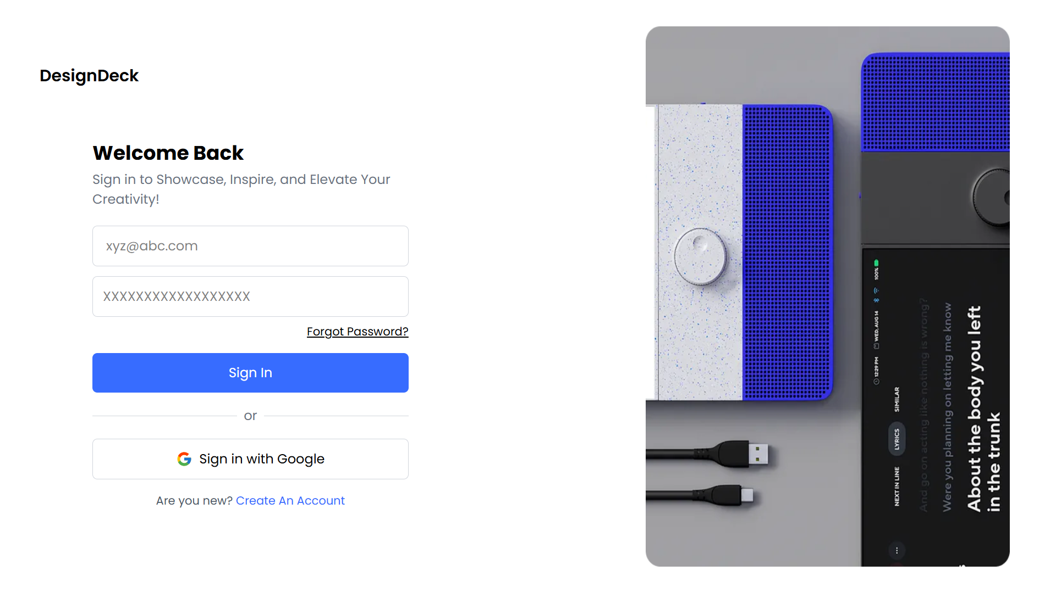
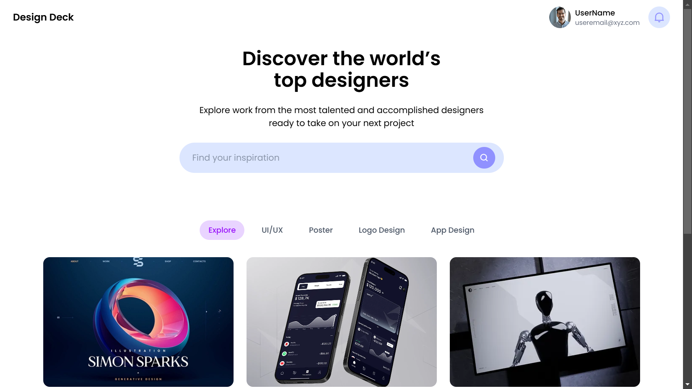
Screenshot Showcase : Frontend Development
Signin Page
Dashboard

Slide 13
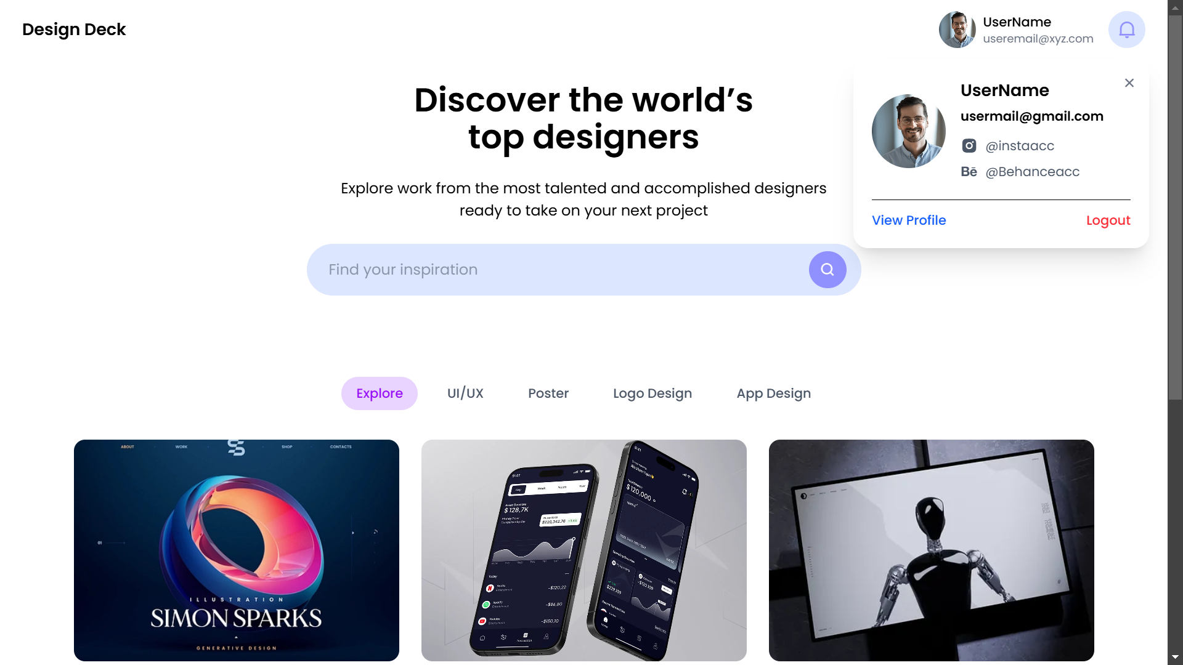
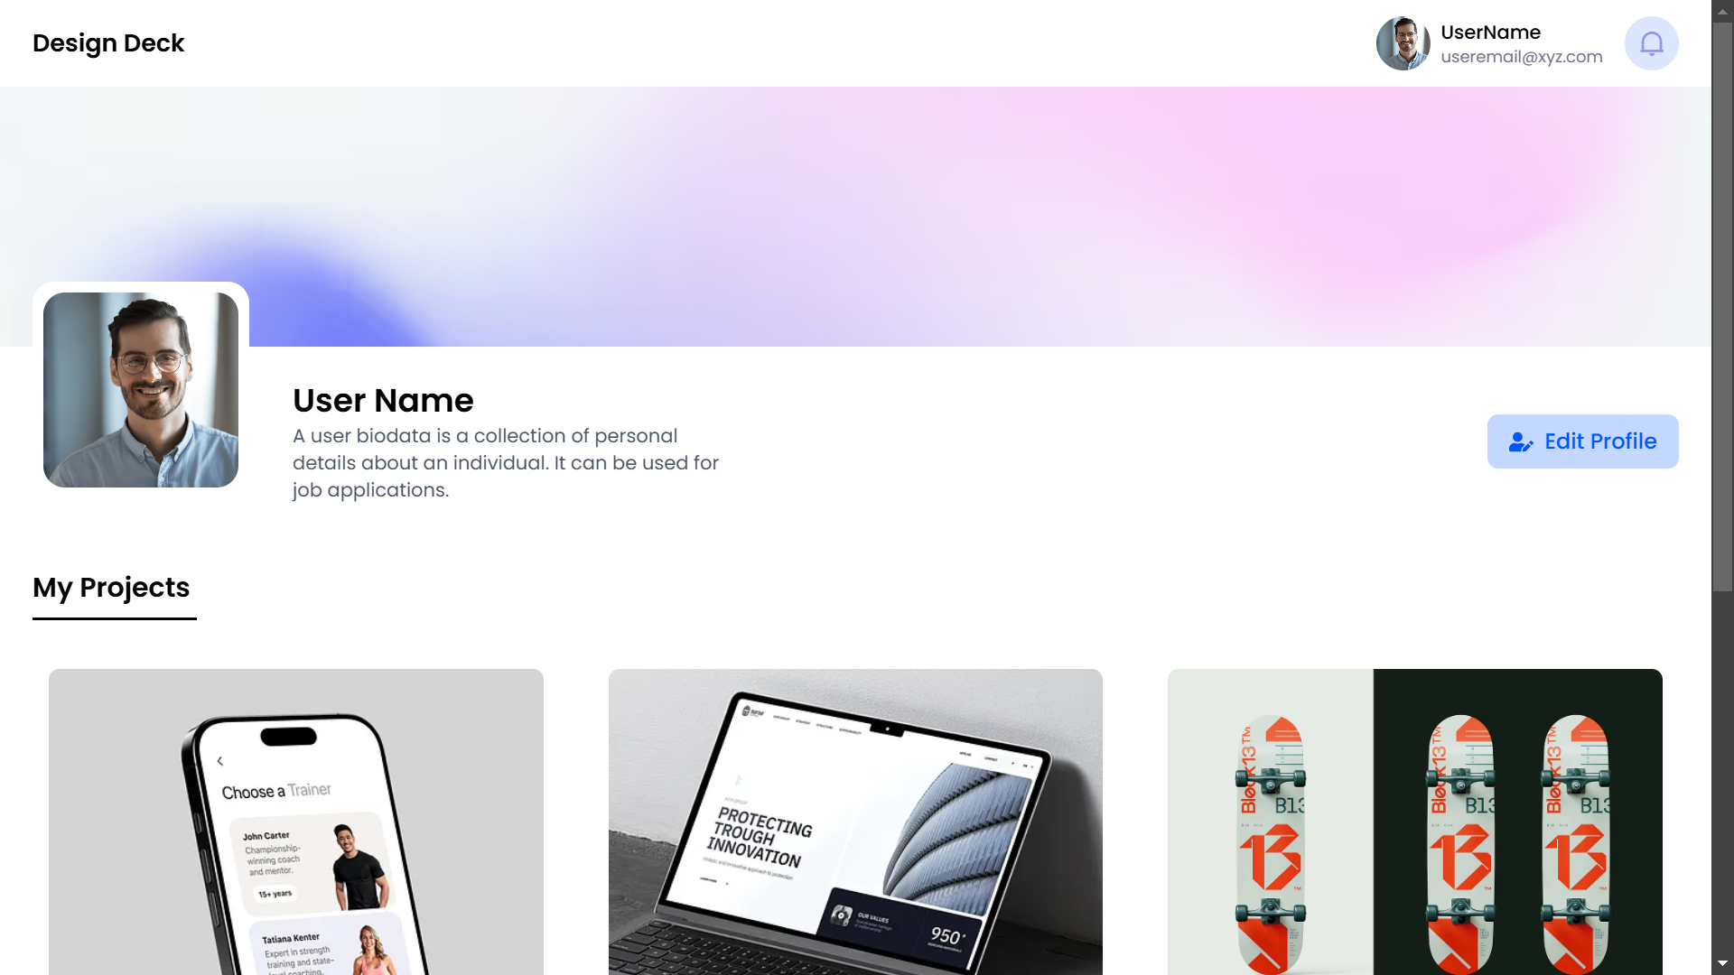
Screenshot Showcase : Frontend Development
Dashboard With Profile Popup
Profile Page

Slide 14
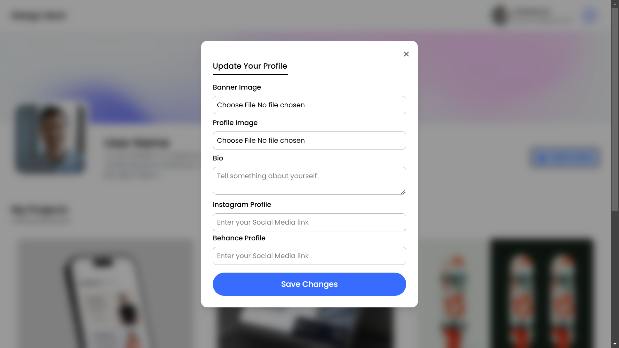
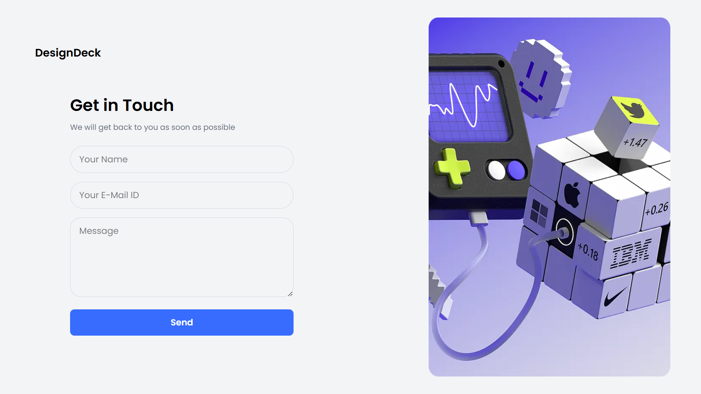
Screenshot Showcase : Frontend Development
Edit profile popup
Contact us page

Slide 15



Next step for DesignDeck
Frontend Development Completed
Connecting Frontend & Backend
Thorough Testing
Ensure functionality, performance, and responsiveness.
Actively build the website's frontend.
Integrate frontend with the backend.

